Slide 1
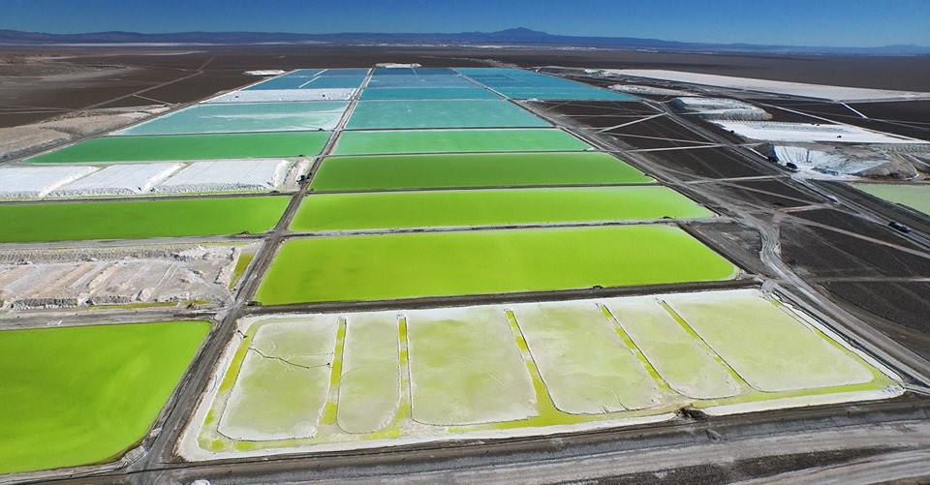
Lithium Mining and Extraction
Where are our batteries derived from?
Soquimich mine, Chile

Slide 2
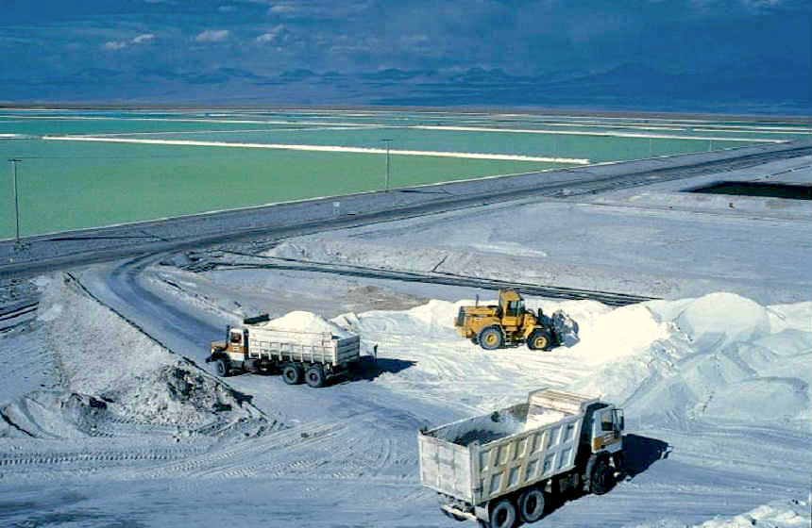
What is Lithium Mining?

Slide 3
Background Information on Lithium Mining
Lithium: the chemical element of atomic number 3, a soft silver-white metal, and the lightest of the alkali metals.
Lithium mining is a set of chemical processes where lithium is isolated from a sample and converted to a saleable form of lithium.
Two major sources which humans extract lithium from include mines and brine water. (Brine is a high-concentration solution of salt in water)

Slide 4
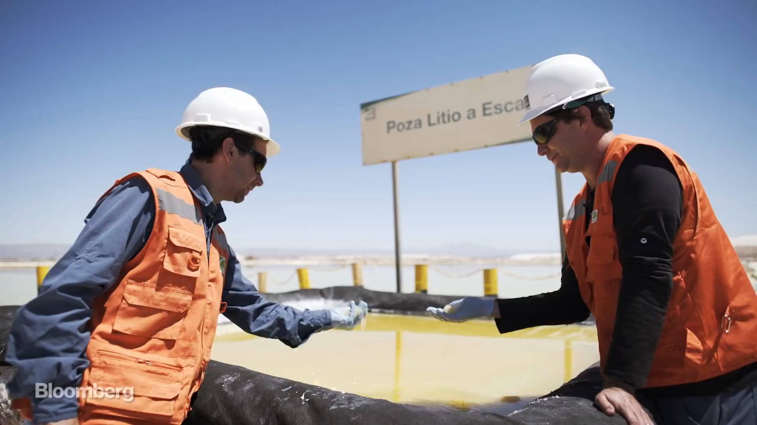

Slide 5
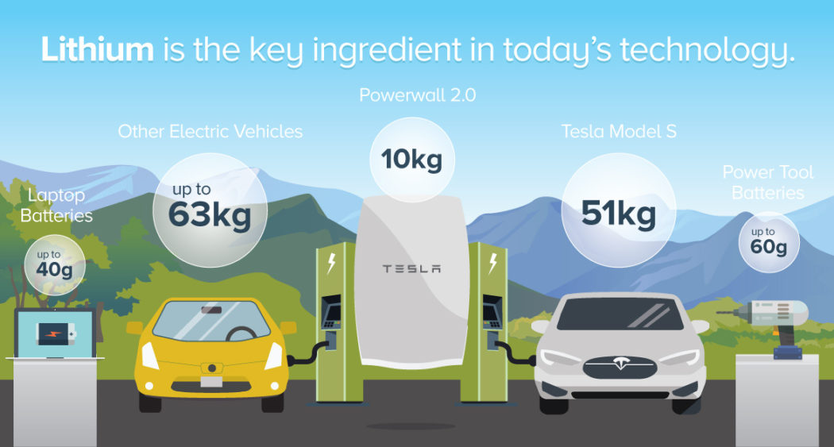
Lithium Mining and Extraction’s Dilemma.
Lithium is the common metal used in our batteries; your toys, phone, computer and many more appliances use lithium-ion batteries.
The mining methods used to harness this precious metal are being done on every continent on Earth, apart from Antarctica.
The by-products of the mining have detrimental effects on local wildlife and civilization, but it seems that any protests to the mining are futile.
- Mass of lithium needed for various forms of technology in today’s world

Slide 6
Lithium Mining and Production in 2016 (Tonnes)

Slide 7

Effects on you and the Environment
People like us aren’t effected by lithium mining, as we don’t live near mines.
Countries like China, Argentina, Chile, and the other countries that see heavy mining are affected the most.
They are drinking water that has by-products of the mining,
35 Tones of dead fish in a river in Hianan Province, China. C.2016

Slide 8
The Stakeholders and their Victims
There are various companies that are mining for lithium around the world, but there are a few big ones.
SQM is the world's largest lithium producer, with mines in the world's biggest mines on every continent.
Albemarle, FMC, are among the top 3 producers.
China has two of the largest producers; Tianqi Lithium and Jiangxi Ganfeng Lithium.
China is expected to be the world leader in lithium production soon, and coupled with their poor sanitation laws, doesn’t look too good.

Slide 9



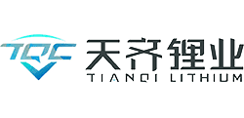

Quick Fact
The 5 aforementioned companies have a combined market cap of US$38 Billion dollars!

Slide 10
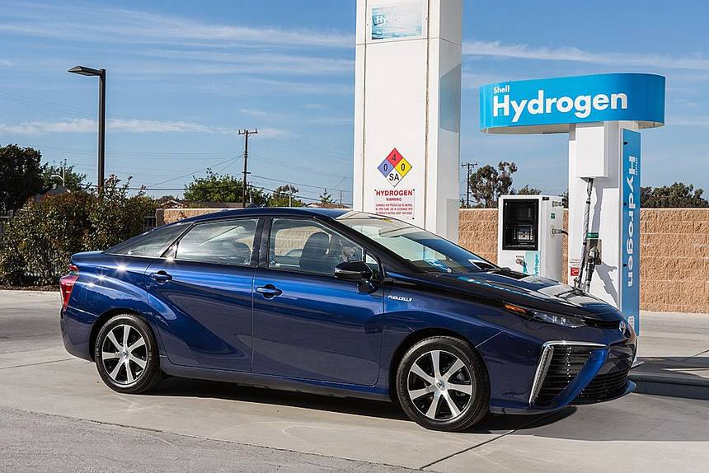
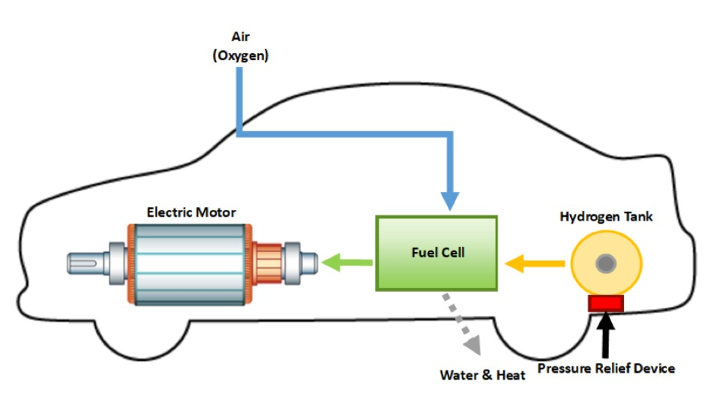
Possible Solutions to Lithium Mining and Extraction
Hydrogen Fuel Cells
In a fuel cell, it combines hydrogen and oxygen to produce electricity, heat, and water. This is converted into electrical energy.
As long as hydrogen is supplied, electricity is continuously produced.
In the future, hydrogen fuel cells can be used as a resource for energy carriers.

Slide 11
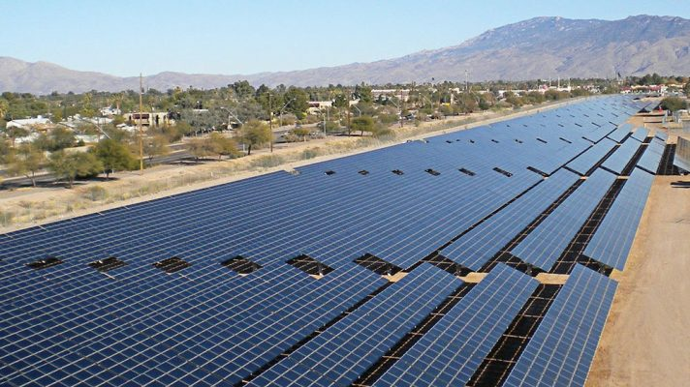
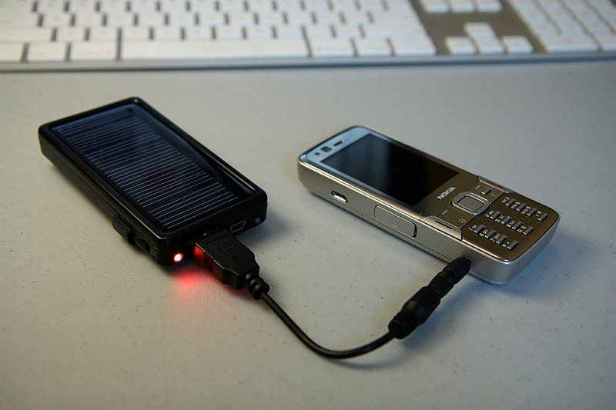
Possible Solutions to Lithium Mining and Extraction Continued…
Solar Panels
In the modern day, solar panels are not as efficient as we may want.
According to Elon Musk, his team is putting serious work into the solar roof.
In the future, solar panels could be capable of being well enough to power an entire car by being entirely self-sufficient .
Solar cell phone chargers also consist of solar panels; they can be used as substitutes for lithium-ion batteries.

Slide 12
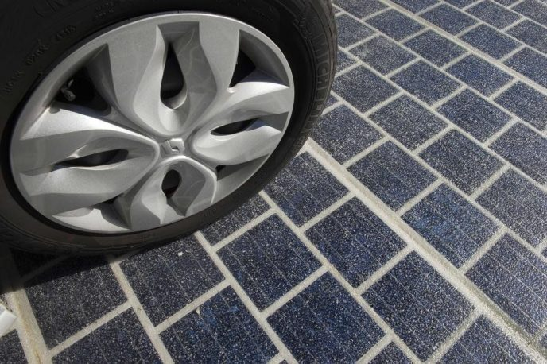
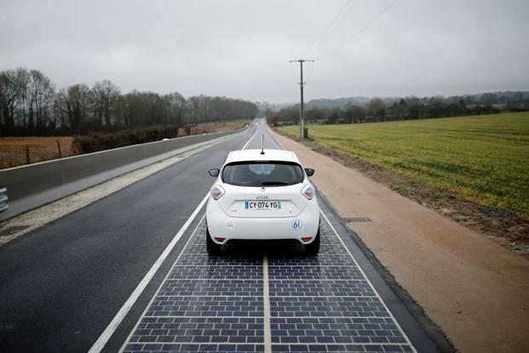
Possible Solutions to Lithium Mining and Extraction Continued…
Powered Roads
There is a such thing as powered roads, which allows for the road to act as power source and the car effectively works like a slot car racer as it absorbs the power.
The batteries in a car would be removed in favor of solar-cells, which will reduce the mass of vehicles too.
This will require roads to be fully-fitted with solar panels, and batteries will have to kept as a back-up is any anomalies occur.

Slide 13
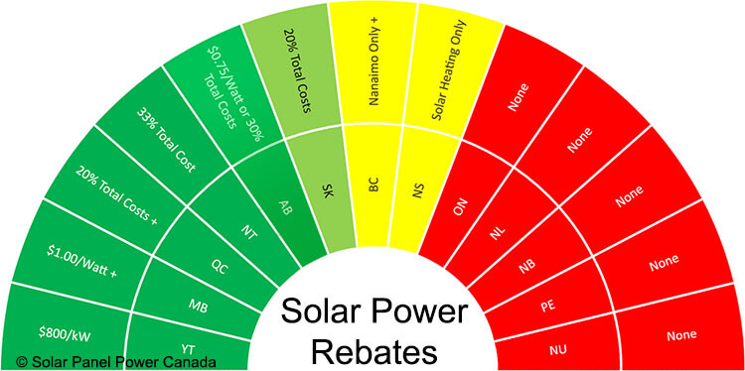
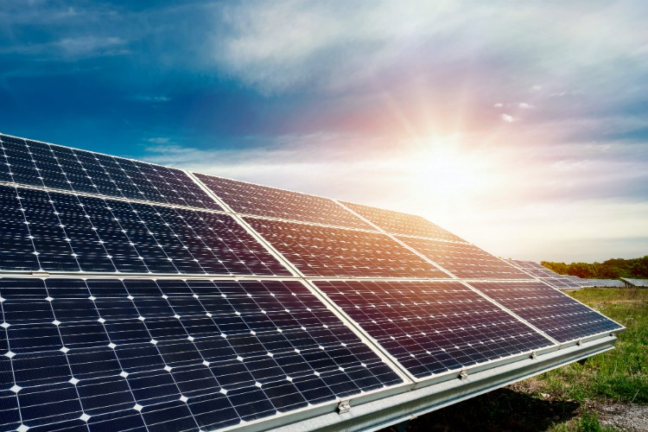
Solution to Human Behaviors Regarding Lithium Mining and Extraction
Solutions
The attitude of humans in modern day towards environmental issues is changing, as we are realizing that climate change is a real issue.
A global energy transition that we’ve taken a part of is to limit ourselves from fossil fields.
What humans can do is by consuming more energy from renewable resources than from fossil-fuels.
This could be achieved with solar panels on your roof, which gives incentives in some provinces like Alberta.

Slide 14
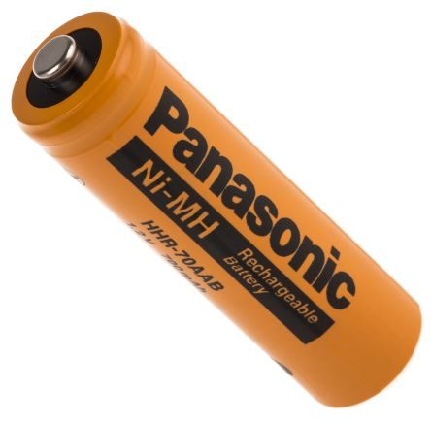
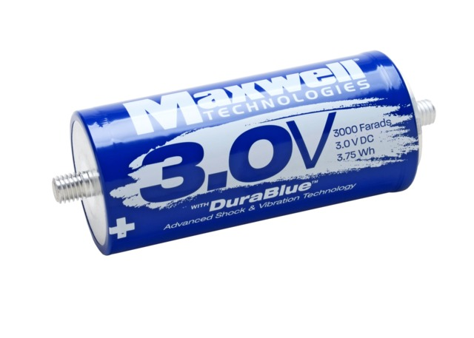

Solution to Human Behaviors Regarding Lithium Mining and Extraction
Solutions
Humans can change their behavior towards the environmental issue behind lithium mining is using rechargeable batteries more often.
In a rechargeable battery, you will have the advantage of having up to 1800 charging cycles.
Supercapacitors and ultracapacitors are solid state devices that offer a source of electricity.
They are found in many computers and electronics.
- Rechargeable battery
-ultracapacitor

Slide 15
Sources
https://www.research-tree.com/blogs/insights/4-lithium-mining-stocks-to-watch-and-why
http://www.lithiummine.com/salt-evaporation-ponds
https://www.thebalance.com/lithium-production-2340123
http://www.lithiummine.com/lithium-mining-and-environmental-impact
https://dgit.com/10-alternatives-lithium-ion-batteries-4242/
https://www.renewableenergyworld.com/hydrogen/tech.html
http://www.mining.com/web/why-lithium-why-now/
https://gcell.com/knowledge-hub/alternatives-to-batteries

